Slide 1

Custom bootcamp week-3
Shivam Jindal

Slide 2
Azure Synapse Analytics
Unified Platform for Data Analytics
Seamless Integration with Data Lake
Robust Data Integration Capabilities
Apache Spark for Big Data
Real-Time Analytics on Streaming Data
Powerful Integration with Power BI
User-Friendly Workspace for Collaboration
Strong Security and Compliance Features

Slide 3
Uses of Synapse
When you need a managed service.
When you have large datasets and complex queries.
Mange structured and unstructured dataset.
Data Pipeline Orchestration.
Analytics on real time operation.
When you want to integrate all Microsoft Azure Service.

Slide 4
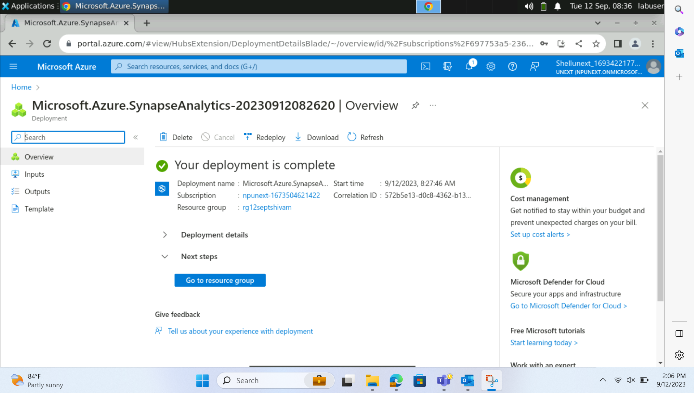
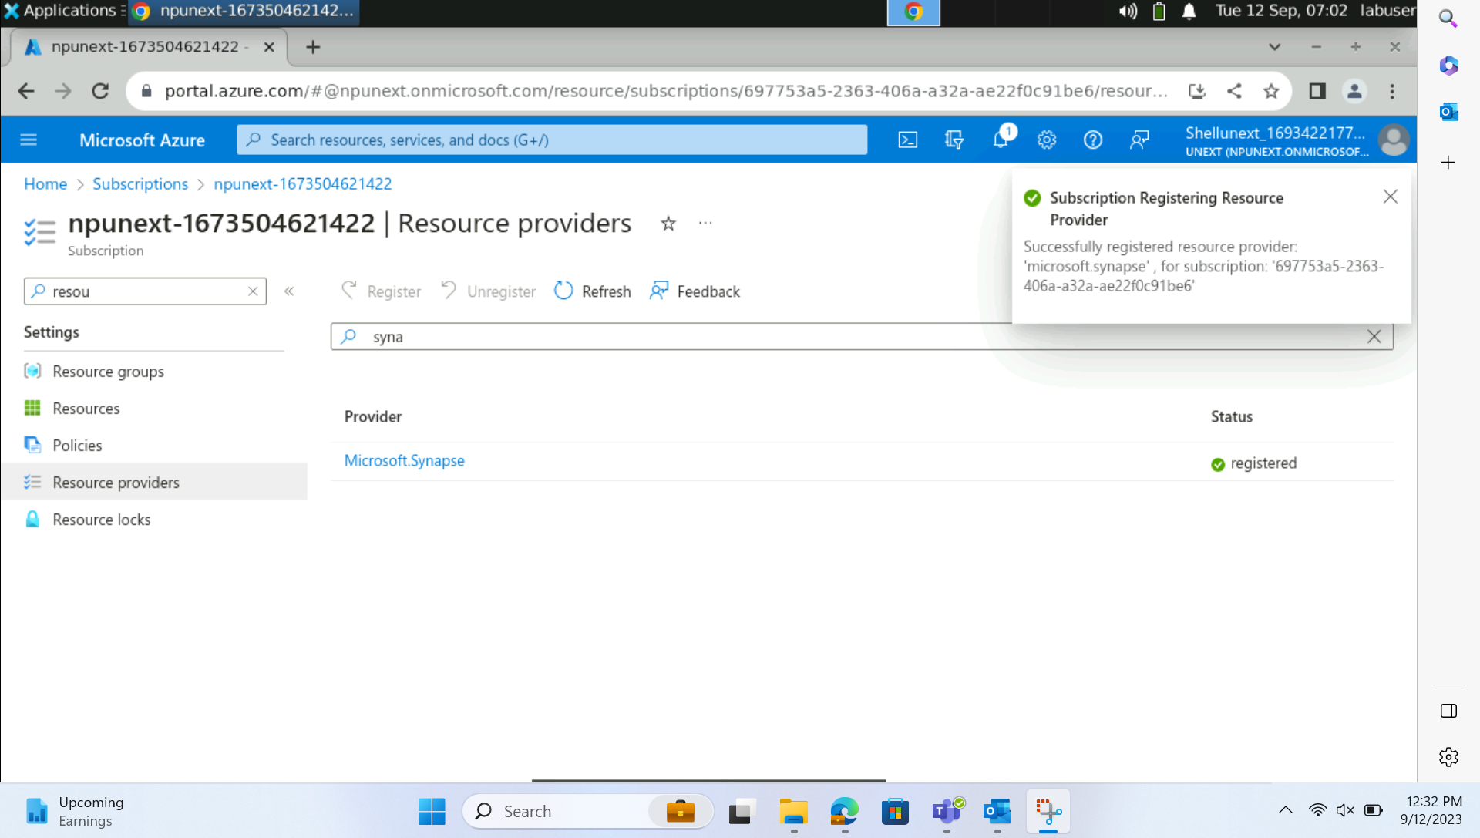
Subscribing Azure Synapse Analytics

Slide 5
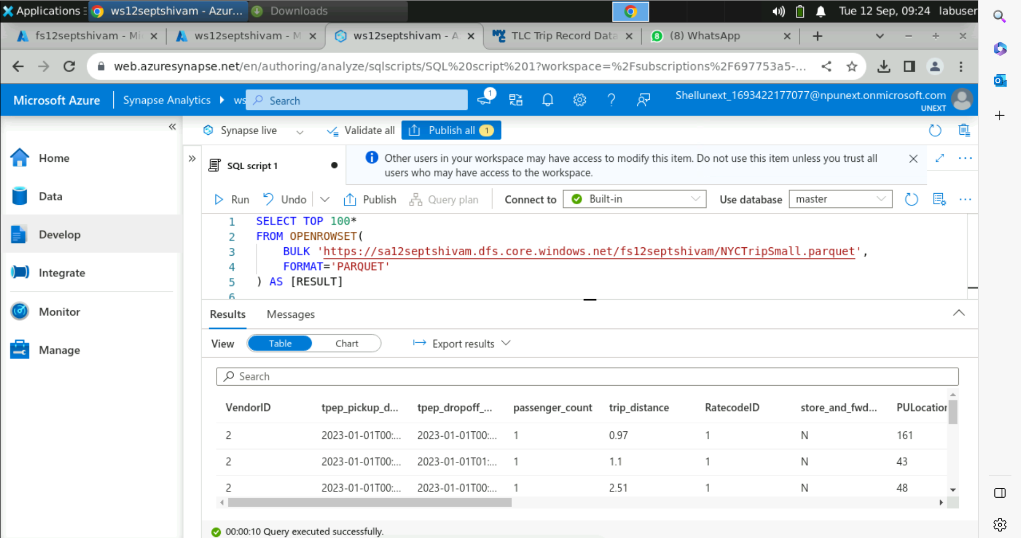
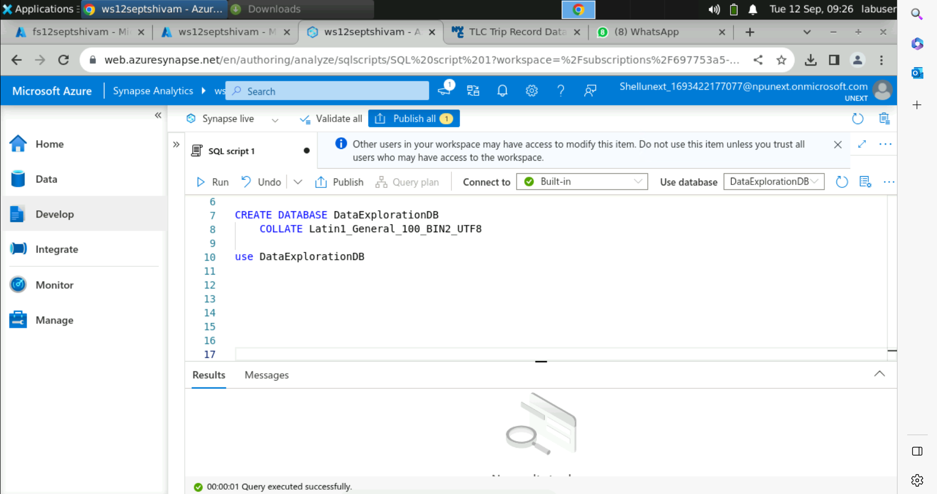
Dynamic Table Using OpenRowSet

Slide 6
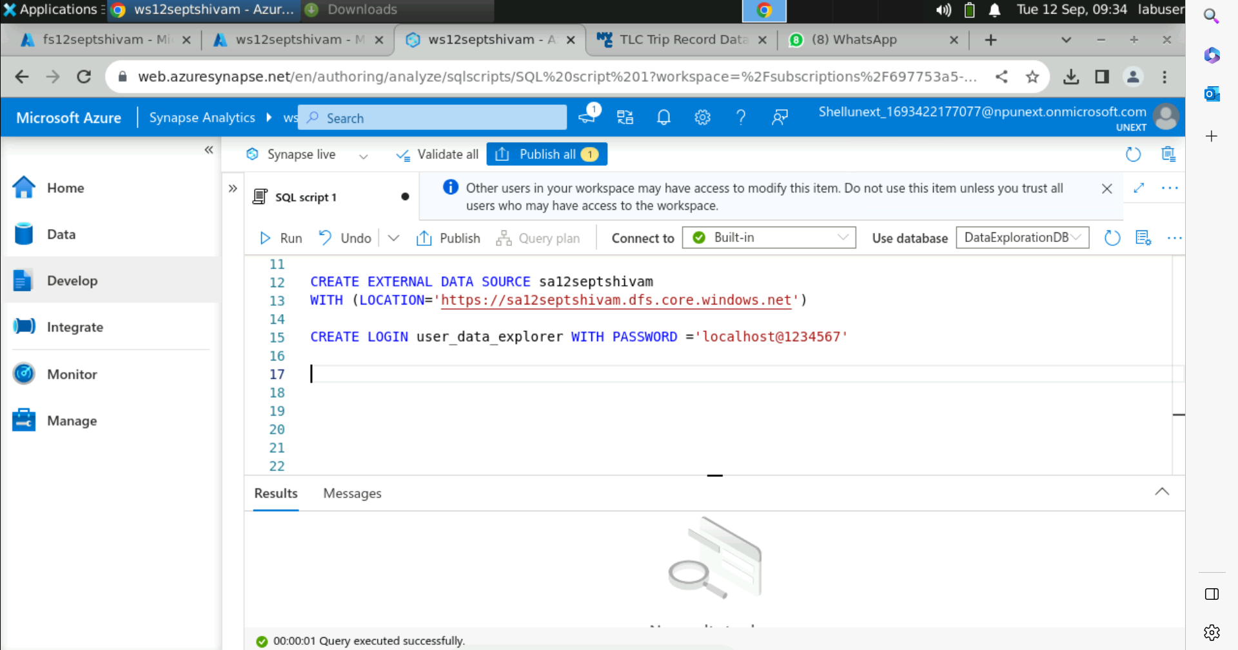
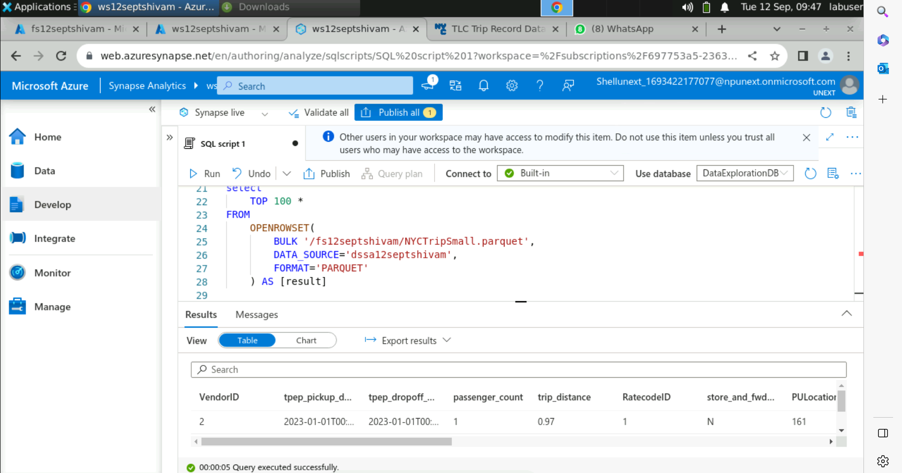
Table using External Data Source

Slide 7
SQL Pools
Serverless SQL Pool
Dedicated SQL Pool
No Dedicated Resources
Variable Performance
Shared Environment
Automatic Scaling
Pay-as-You-Go
Ad-Hoc and Unpredictable Queries
Dedicated Resources
High Performance
Multi-User and Multi-Query Concurrency
Vertical and Horizontal Scaling
Fixed Cost
Large Enterprises with Predictable Workloads

Slide 8
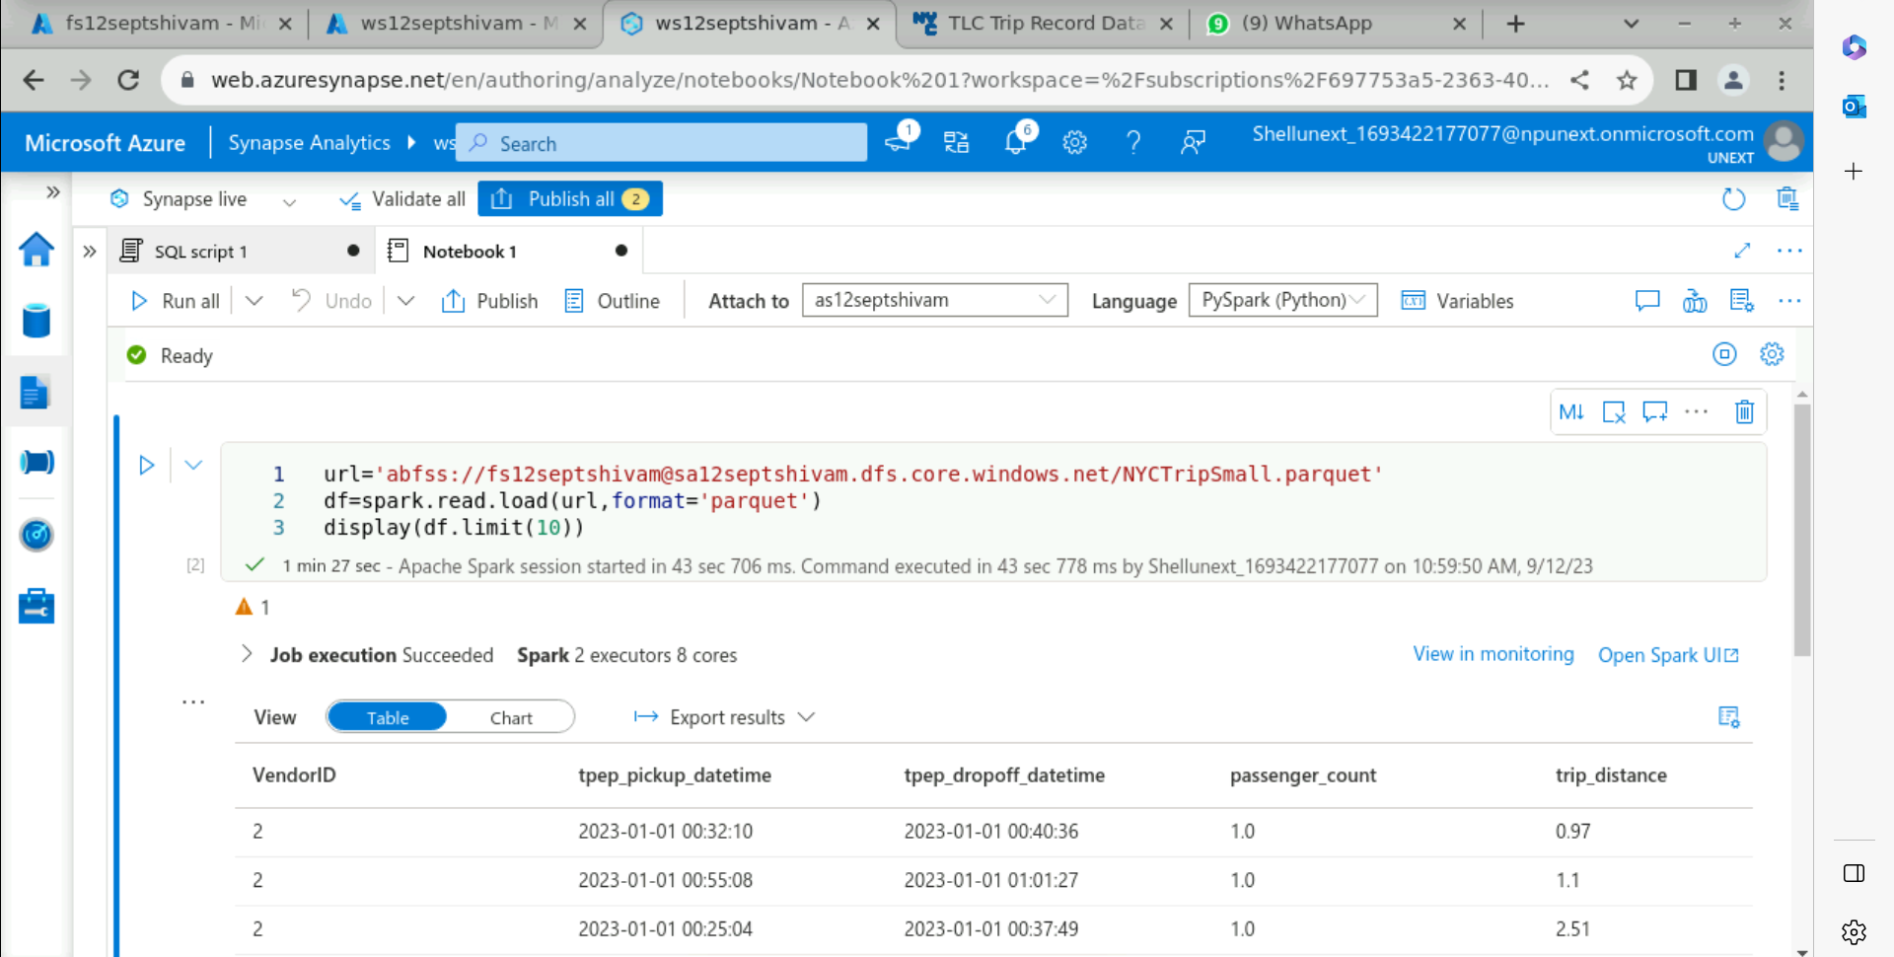
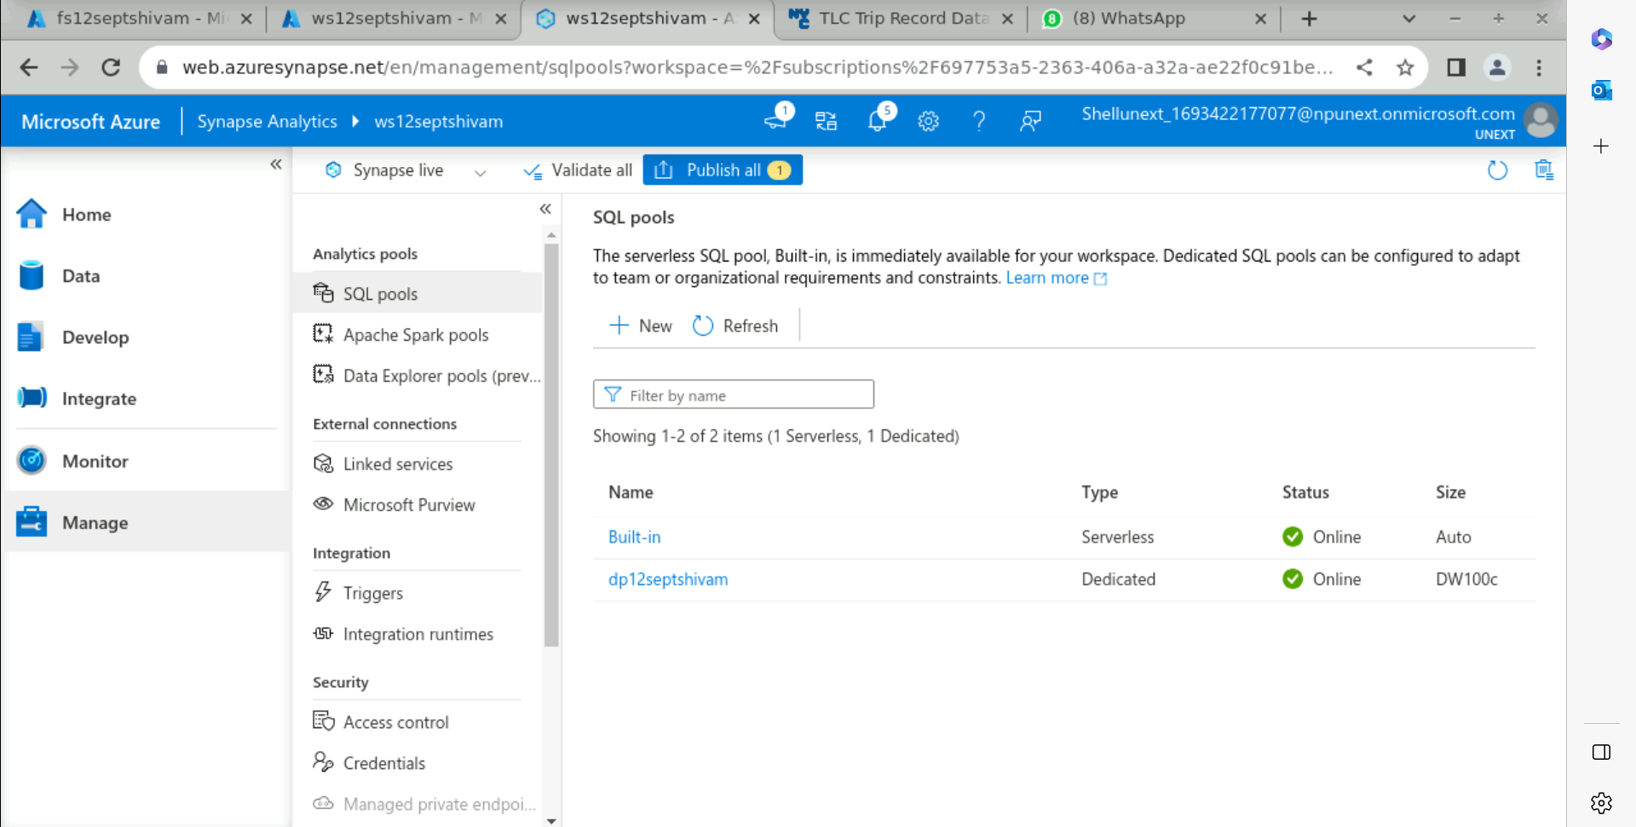

Slide 9
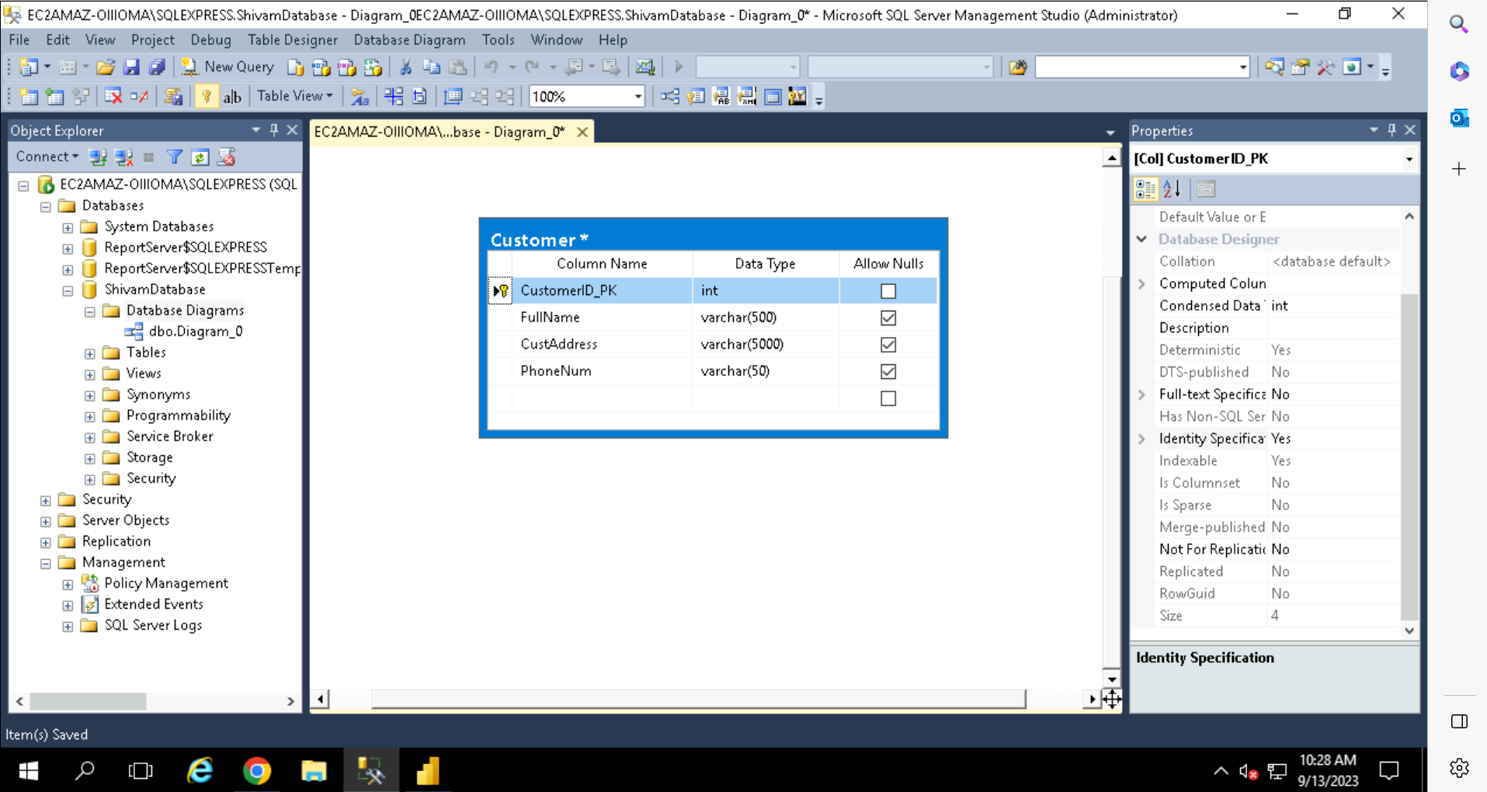
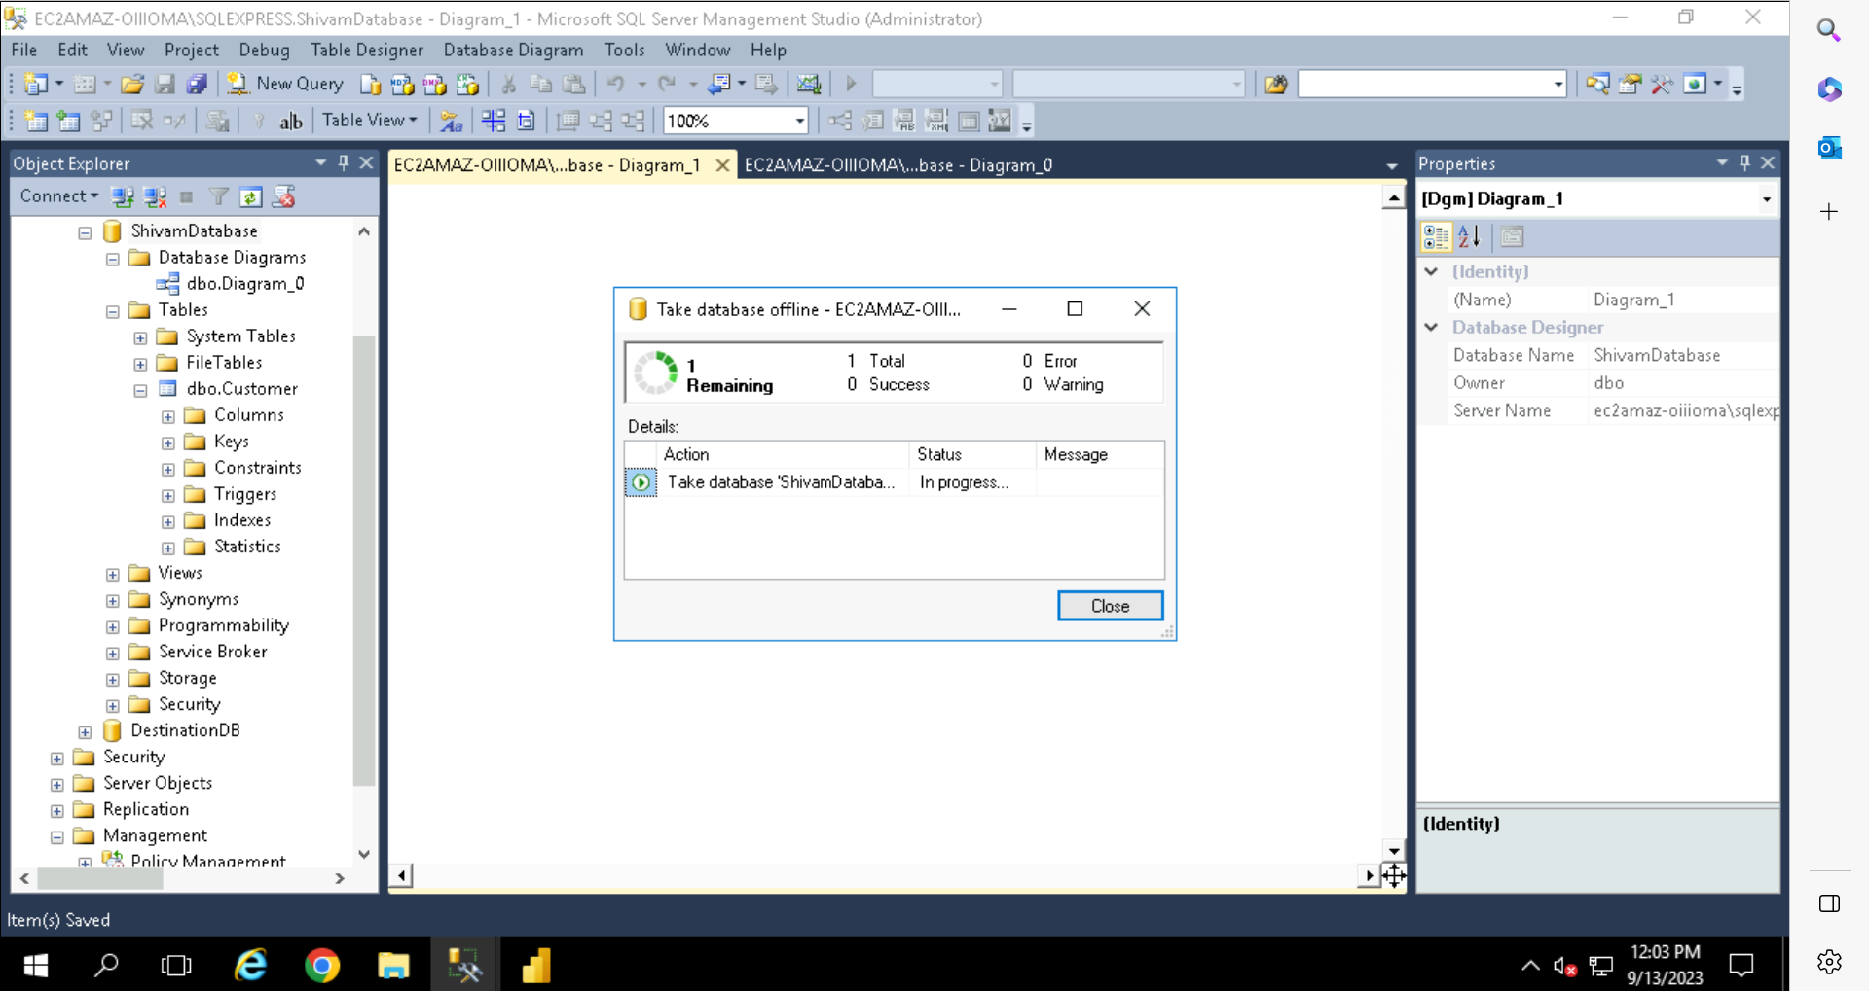
Data Visualization Using Power BI

Slide 10
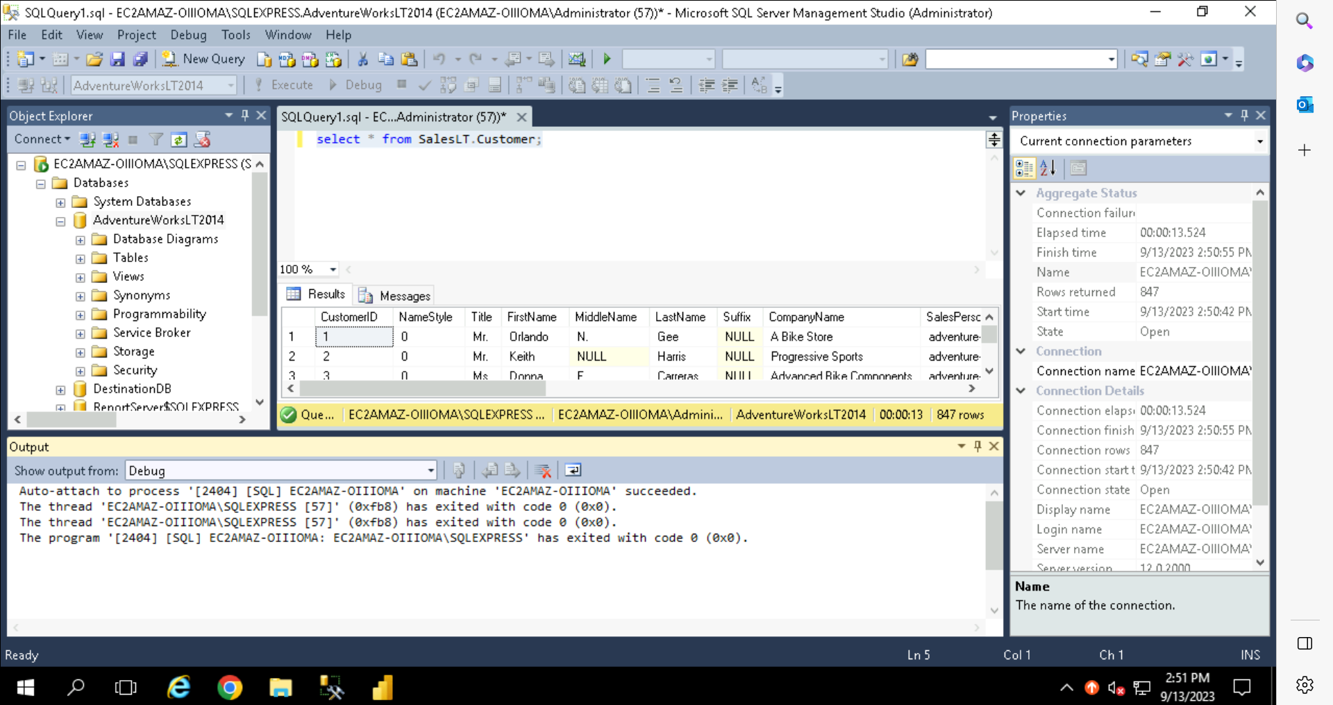
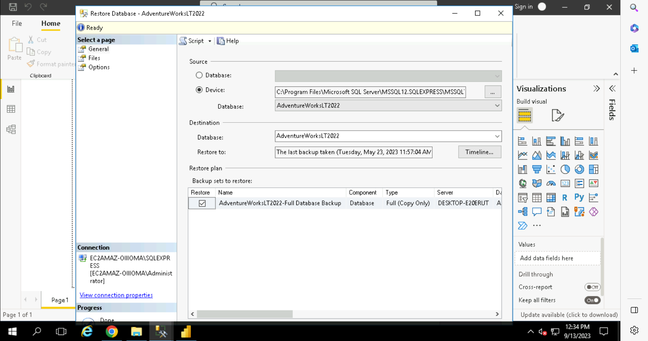

Slide 11
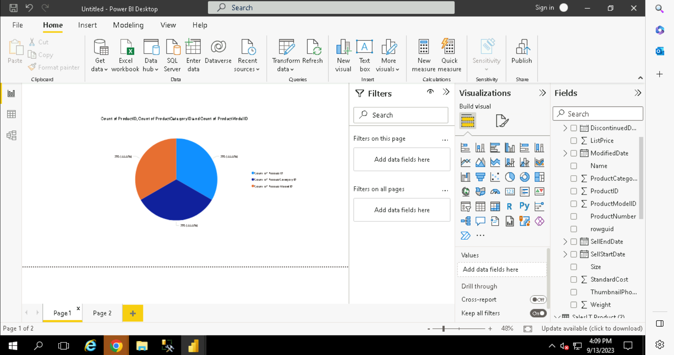
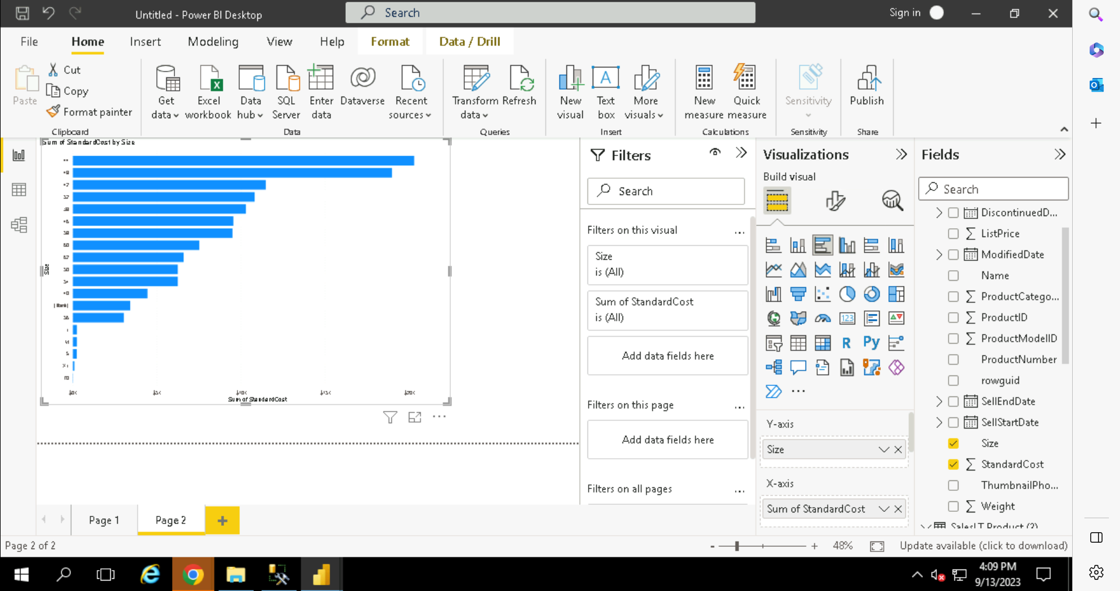

Slide 12
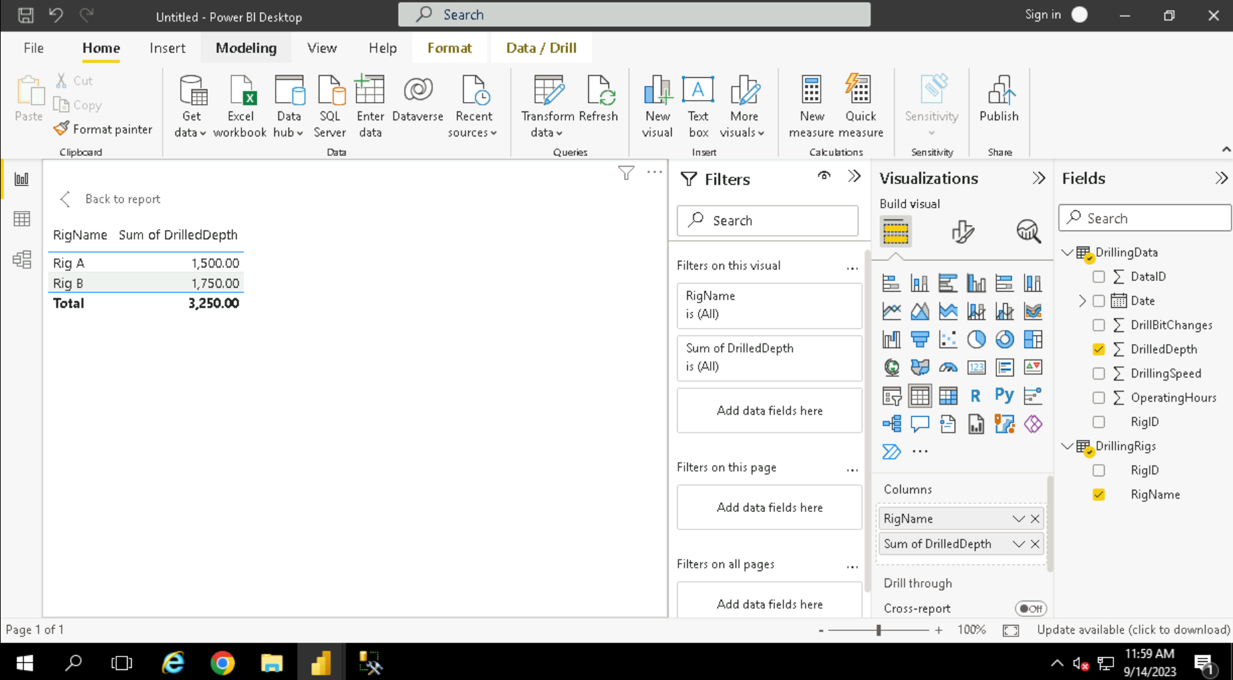
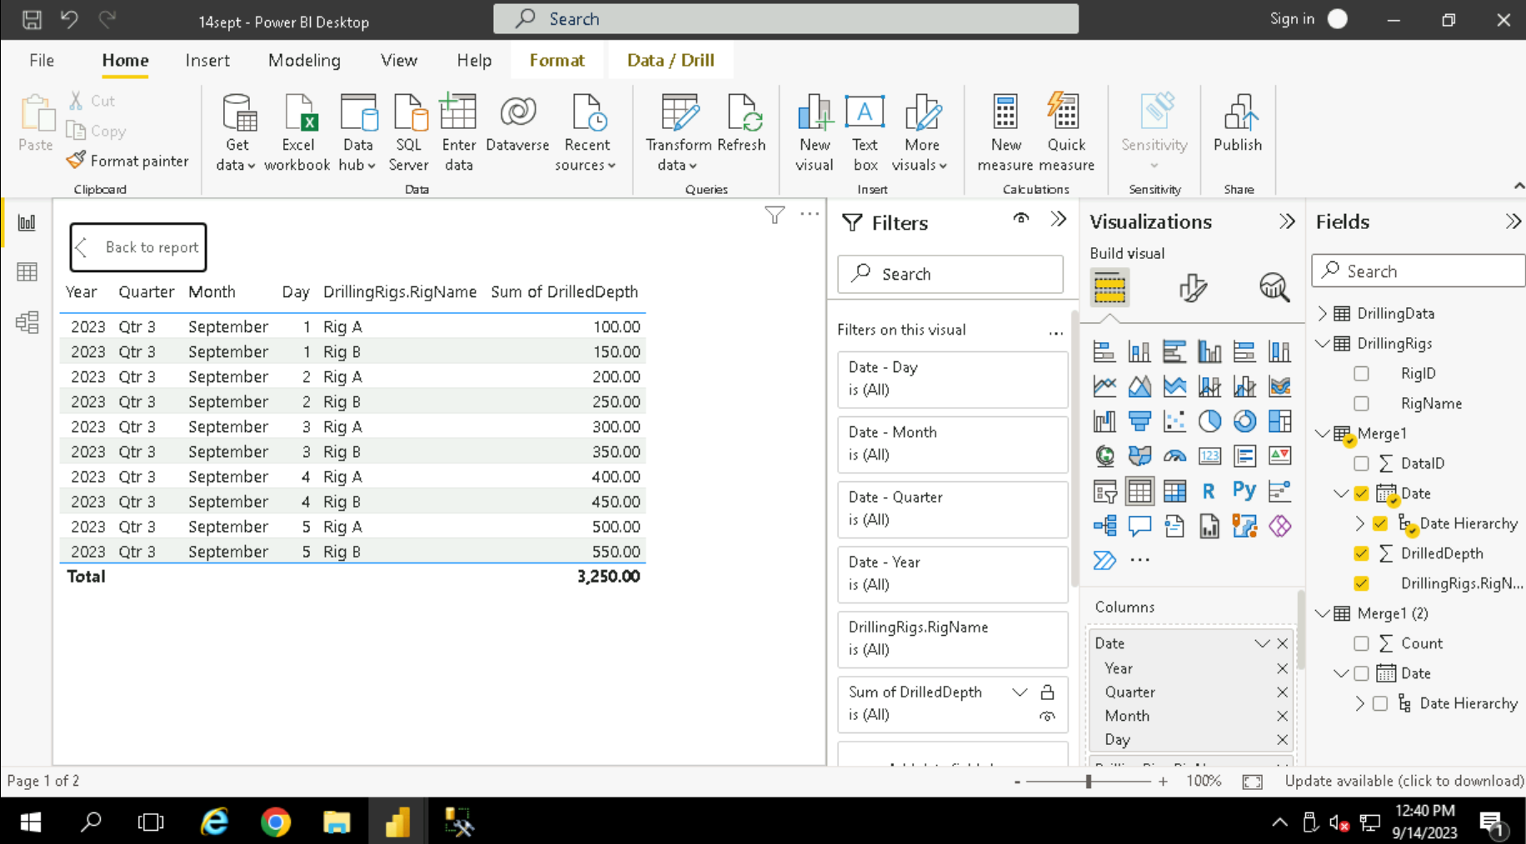

Slide 13
Python
General-purpose, high-level programming language.
Interpreted, no compilation needed for execution.
Versatile, used in various domains.
Dynamically typed, no explicit type declarations.
Large standard library, extensive built-in modules.
Readable syntax, easy to understand.
Active community, rich ecosystem of libraries.

Slide 14
Conditional Statements and Operators in Python
Conditional Constructs
Iterative Constructs
Arithmetic Operators
Logical Operators
Control Structures and User Defined Functions
Loops (While, For, Break and Continue)

Slide 15
Functions and Methods
User Defined
Lists Slicing
List Manupulation
Command Line Arguments
Iterables and Iterators
List Comprehension
Lambdas and Map
Tuples and Dictionary
Lambdas and List Compression

